Slide 1
Cyclistic Bike-Share
Presented by: Atharv Verma
Last Updated: November 2nd, 2024

Slide 2
Table of Contents
Cyclistic Bike-Share
Problem statement and business task
Data preparation and processing
Data Analysis
Conclusion
Appendix

Slide 3
Problem statement and Business task

Slide 4
About the company
Cyclistic is a Chicago-based bike-sharing company, since 1960 Cyclistic offers a fleet of 5,824 geotracked bikes across 692 stations with flexible pricing options for casual and member riders.
Cyclistic aims to increase profitability by converting casual riders into annual members through targeted marketing.
Objective
To convert casual riders to annual members to increase profitability.
Analyze Cyclistic’s trip data to understand differences in bike usage patterns between casual riders and annual members

Slide 5
Data preparation and processing

Slide 6
About the data
The data was conducted via DIVVY & the City of Chicago and made available to us via Data License Agreement.
Consists of previous 12 months of data, from 01/2023 to 12/2023.
Data contains approximately 11 million data points.
Data is 1st party, public data indicating high integrity.
Data Limitations
Due to Consumer Protection laws, we can’t see customers past purchases.
We don’t have access to distance rode per trip.
Some null values and inconsistent formats within the data.

Slide 7
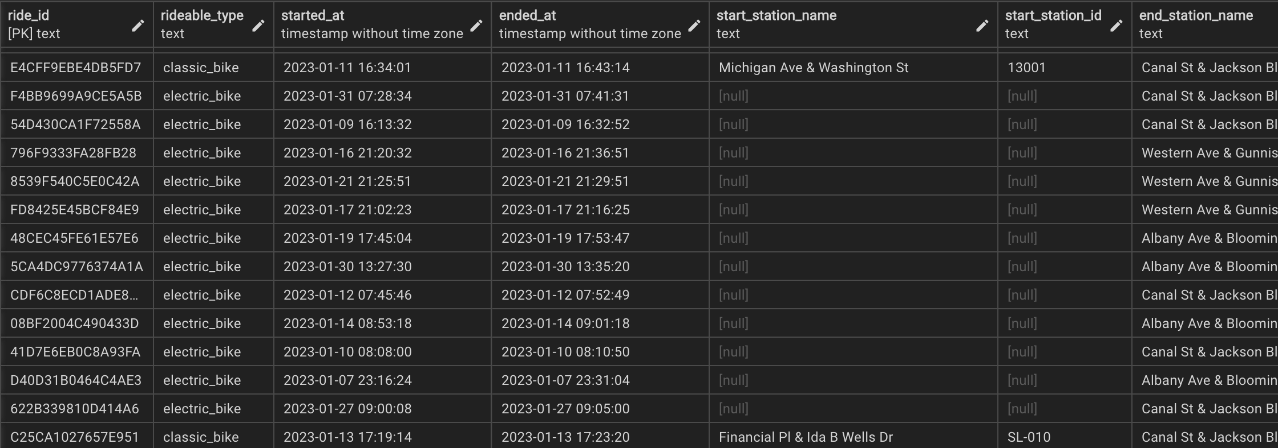
Data Cleaning
Tools Used: SQL & R
Data with null values are kept
Irrelevant columns like ride_id, start_station_name, start_station_id, end_station_name, end_station_id, and start, end coordinates are dropped.

Slide 8
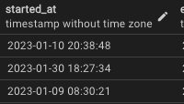
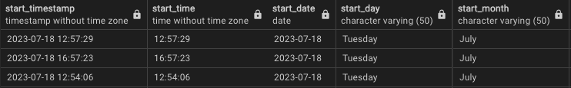
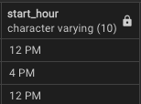
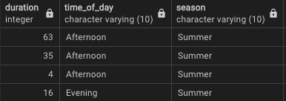
Data Processing
Split timestamps into date, time ,month, day, hour
Duration(end_time – start_time) column is added.
Time_of_day column is added.
Season column is added.

Slide 9
Data Processing (Cont.)
Original data format:
Converted data format:

Slide 10
Data Analysis & Insights

Slide 11
Introductory Statistics
Average trip duration: 18 minutes
Maximum trip duration: 98500 minutes
Most frequenty start day: Saturday

Slide 12
Overall Rides
Total Rides in 2023: 11,249,453
Casual Rides: 4,078,350
Member Rides: 7,171,103

Slide 13
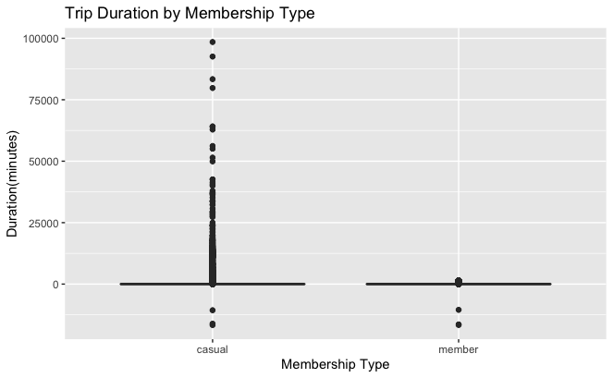
Ride Duration
Casual riders ride for longer duration
Casual ride duration is scattered or varying
Member riders ride for shorter duration
Member ride duration is fairly consistent for majority of riders.

Slide 14
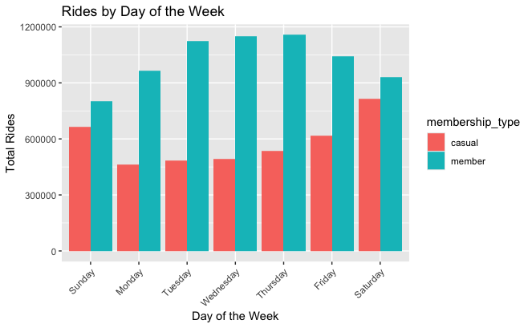
Weekly Rides
Casual rides are almost half of Member rides on weekdays.
Casual rides almost catch up to Member rides on weekends.
Casual riders ride more on weekends.
Member riders ride more on weekdays.

Slide 15
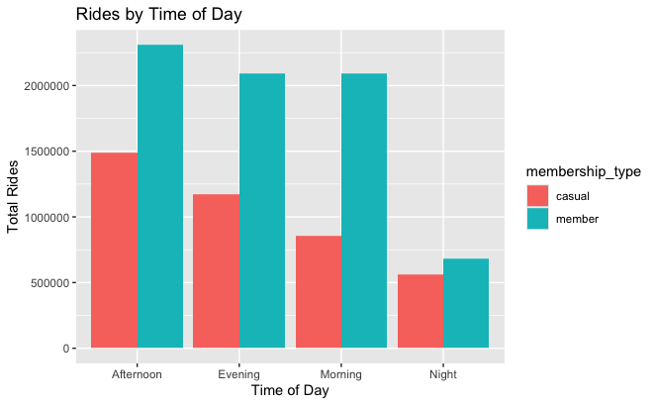
Time of Day Rides
Afternoons are the busiest.
Rides are lowest at Night hours.

Slide 16
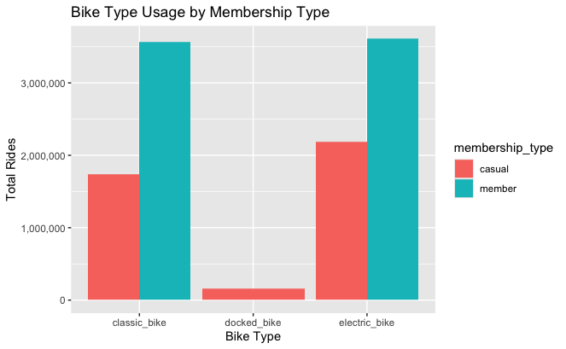
Bike Type
Docked bikes are only used by Casual riders
Member riders do not prefer docked bike
Electric bikes are most popular among Casual riders

Slide 17
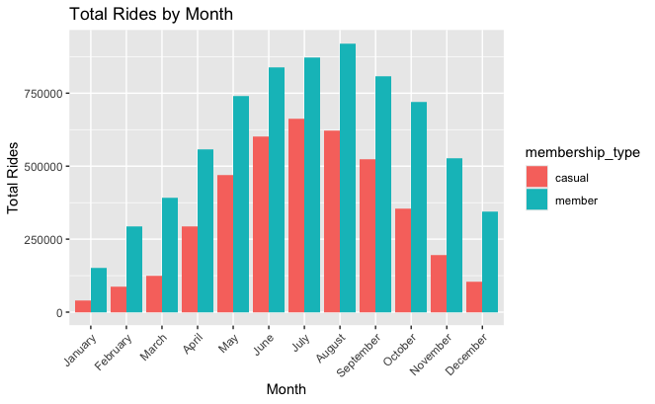
Monthly Rides
Hot months like June, July, and August are the busiest

Slide 18
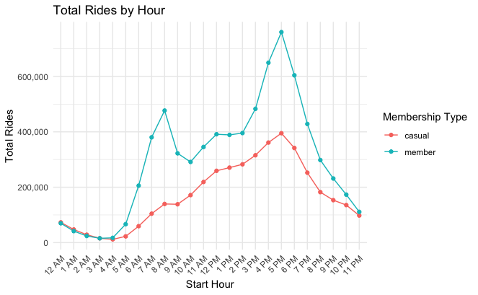
Hourly Rides
Casual rides peak till 5PM
Member rides correlates to the standard office hours

Slide 19
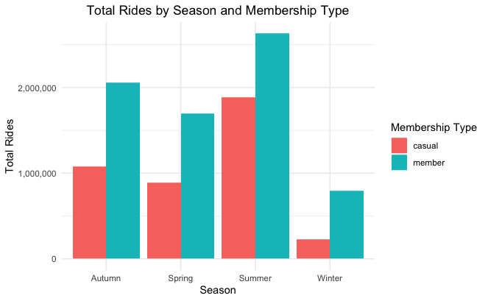
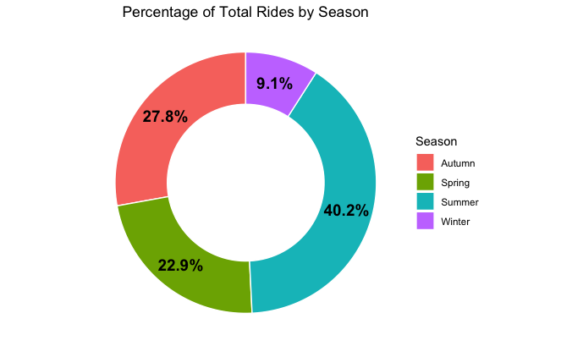
Rides by Season
Summer months are the busiest
Massive fall-out in Winter

Slide 20
Conclusion

Slide 21
Suggestions
Boost marketing during summer months
Create in between tier for memberships to appeal to the casual riders
Give discounted prices for memberships during winter months.
* This analysis only focuses on differences between casual and member riders. Further analysis is needed.

Slide 22
Appendix

Slide 23
References & Links
Original data source: https://divvy-tripdata.s3.amazonaws.com/index.html
R Markdown file : file:///Users/atharv/RTutorials/Cyclistic_2023_data_viz.Rmd

Slide 24
THANK YOU

